Slide 1
POST EXPLOITATION PROCESS CONTINUATION OF DOOM

Slide 2
To Quote redpantz
A guy who wears red pants recently said
The era of simple exploitation is behind us and more exploitation primitives must be used when developing modern exploits

Slide 3
Code Execution Is Only The Beginning
Back in two thousand and zero
I found some bugs
Published some exploits that spawned a remote shell
Dave Aitel asked me
Why would you want to run cmd.exe?
Because that’s what the cool kids do?

Slide 4
Dare I Say It
Dave was right
Spawning a cmd.exe shell was wrong
You lose control of the ‘execution flow’
Permissions prevent cmd.exe execution
Agent Deployment
Canvas
Meterpreter
Core Impact
Others…
Post Agent Deployment
Unstoppable?
Allow post exploitation interaction

Slide 5
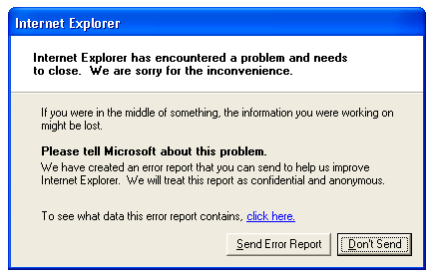
Agents Worst Enemy

Slide 6
Agents Worst Enemy

Slide 7
The ‘Giveaway’
Errors like that might be ok if
You going after a ma and pa outfit
You have travelled back 10 years
Target is mass market, high volume low value
Unacceptable when
Red team exercises
APT style gOOgle attacks (shoutz to hntr and sham)
Low volume, high value
You value your rootite
our rootite is valuable

Slide 8
Why Protect Out Rootite
% of 0days are discovered through bad exploits
The ‘App Crash’ syndrome
Exploit discovery
AV
IDS
Network traffic
Activity
‘App crashed’ so what's up activity
According to Nico

Slide 9
From Rootite To Exploit
It’s a multistep process
Rootite Miners
On the coal face
Fuzzing, auditing, digging
No rootite, no exploit
Trigger Generator
Fine tune the bug trigger
Find edge cases
Minimalise trigger
Exploit Writer
Turn trigger into code exec
Bypass DEP/ASLR
100% reliability

Slide 10
From Rootite To Exploit
It’s a multistep process
Payload Developer
Intelligent payload
Integration with exploit
100% reliability
Delivery Method
Refined spearfishing
100% AV bypass
Minimalise side effects
Post Exploitation
Hidden communications
Persistence
Stability

Slide 11
From Rootite To Exploit
Each section relies on the previous
Won’t work without each other
Weakest link in the chain
*$$$$*
Time costs money
Immunity has discussed cost of writing an exploit
MS12-020 – Recent RDP vulnerability
One solution to protect investment
Post Exploitation Process Continuation
That means the target process continues to execution after the exploit has completed its mission

Slide 12
Lazy Sundays
Most public exploits are very similar

Slide 13
_0_0_
Exploits use old techniques
Use of methods that were public years ago
Not much ‘progression’
Public shellcode
Used to see advances in shellcode
Smallest, Fastest
Common to see metasploit shellcode
Great tool, great guys
Exploits created with little understanding of shellcode

Slide 14
So What Makes Up An Exploit
Talking about the step between trigger and payload
Rootite Miners
Trigger Generator
Exploit Writer
Turn trigger into code exec
Bypass DEP/ASLR
100% reliability
Payload Developer
Delivery Method
Post Exploitation

Slide 15
So What Makes Up An Exploit
Occurs post execution control
FindSelf
Usual fstenv or call / pop
LoadAddress
Standard IAT parsing
DoFunction()
Migrate/Spawn/Connect
Exit()
TerminateThread()
TerminateProcess()

Slide 16
So What Makes Up An Exploit
Introduce some DEP bypass
Bypass DEP
Drink if I say ROP
FindSelf
Usual fstenv or call / pop
LoadAddress
Standard IAT parsing
DoFunction()
Migrate/Spawn/Drink
Exit()
TerminateThread()
TerminateProcess()

Slide 17
Working In Confined Spaces
Introduce some egg hunting
EggHunter()
Search code to find main payload
FindSelf
Usual fstenv or call / pop
LoadAddress
Standard IAT parsing
DoFunction()
Migrate/Spawn/Drink
Exit()
TerminateThread()
TerminateProcess()

Slide 18
Working In Confined Spaces
Introduce some egg hunting
Bypass DEP
I didn’t really say ROP did I?
EggHunter()
Search code to find main payload
Bypass DEP
Yes bypass it again
FindSelf
Usual fstenv or call / pop
LoadAddress
Standard IAT parsing
DoFunction()
Migrate/Spawn/Drink
Exit()
TerminateThread(), etc.

Slide 19
SyScan Rocks!
Nothing new here
Dep bypass is common place
ASLR ‘bypass’ is pretty common
Egg hunting shellcode is old school
Skapes egghunt code is commonly used
Published in or before 2003
Its slow and inefficient
No publicly released new code
No innovation?

Slide 20
Skapes Code
For those that are familiar with it
or dx,0x0fff ; get last address in page
inc edx ; acts as a counter ;(increments the value in EDX)
push edx ;(saves our current address on the stack)
push byte +0x2 ; push 0x2 for NtAccessCheckAndAuditAlarm
pop eax ; pop 0x2 into eax so it can be used as parameter
int 0x2e ; kernel syscall
cmp al,0x5 ; check if access violation occurs
pop edx ; restore edx
je xxxx ; jmp back to start
mov eax,0x50905090 ; this is the tag (egg)
mov edi,edx ; set edi to our pointer
scasd ; compare for egg
jnz xxxxxx ; back to inc edx
scasd ; compare for egg
jnz xxxxx ; jump back to "inc edx"
jmp edi ; jump to the found location

Slide 21
Skapes Code
For those that aren’t familiar with it
Search memory byte at a time
Looking for 2 consecutive dwords
For x in 1 to EndOfMemory
If IsMemoryValidToRead()
If FindOurEggHere()
GoThere()
End If
End If
Memory+=1
Next

Slide 22
I Like Egges With Bacon
Yes it works
But its slow, and inefficient
Doesn’t work on x64 based Windows
And won’t be enough for what I want to do
A new and more efficient method must be developed
The era of simple exploitation is behind us and more exploitation primitives must be used when developing modern exploits

Slide 23
Seriously though
We understand the structures
PEB, TIB, Heap blocks
Totally documented
Great tools for analysis
You need a new search algorithm
Intelligently parse the target memory space
Search through known valid heap blocks
Traverse thread stacks

Slide 24
Back To The Present
Common exploitation termination is
Spawn/Migrate to a process
Call TerminateThread() or TerminateProcess()
The end user sees…
My app just disappeared
Another error box
Why is calc.exe running?
Purpose of this talk
Exploits need to be more intelligent
Want to encourage public work in the space of process continuation

Slide 25
Agents
Agent Deployment
Intelligent payload
Allows querying of target address space
Fast.
Target Process
Attack Control Point
Two Way Communications

Slide 26
Post Exploitation Process Continuation
Very application specific
But then so are current exploits
Examples are on windows XP
Because it really doesn’t matter
Already bypassed DEP/ASLR
Already executing code

Slide 27
Simple Win
Instead of causing process termination
Just call suspend thread
In a multithreaded application, suspending the corrupted thread may be enough

Slide 28
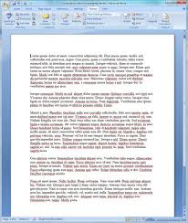
File Droppers
Commonly used by word/pdf trojans
Exploit writes a new file to disk
Spawns a new word/adobe to load file
Calls TerminateProcess()
Exploit Runs
Write File
Spawn MSWord

Slide 29
File Droppers
Main process still exits
To the user it looks like a slow file load
Can be used on any file format bug
Simple to achieve
Force the new process to the front
Silently kill the old process

Slide 30
Stack Corruption Bugs
Need to create snapshot
Registers
Stack
Overwrite as little as possible
The less to clean up the better
Work out what is important
Not all values will be needed
Return address always required
Recreate stack
Reset registers and continue execution

Slide 31
Stack Recreation
Exploit runs
Create new thread (suspended)
Copy 2nd stage to new thread
Start new thread
Suspend corrupted thread
Corrupted Thread
SUSPENDED
New Thread
2nd Stage Shellcode

Slide 32
Stack Recreation
Recreate stack
Build new stack on engine or with 2nd stage
Transfer new stack contents to corrupted thread
Reset thread registers using SetThreadContext()
Resume thread
Fixed Stack Thread
Process Continuation
New Thread
2nd Stage Shellcode

Slide 33
How To Recreate The Stack
Classify data types
Static value
Ptr to loadable module
Ptr to stack address
Ptr to heap address
03D1F858 0142C510 ÅB [HEAP #4 Segment 2]
03D1F85C 014306A0 C [HEAP #4 Segment 2]
03D1F860 00000000 ....
03D1F864 6F346789 ‰g4o ASCII "loading" [ STATIC ]
03D1F868 6F346907 i4o ASCII "RealText" [ STATIC ]
03D1F86C 03D1F9DF ßùÑ [ STACK ]
03D1F870 03D1F9D8 ØùÑ [ STACK ]
03D1F874 03D1F9D8 ØùÑ [ STACK ]
03D1F878 03D1F9D8 ØùÑ [ STACK ]
03D1F87C 03D1F9D8 ØùÑ [ STACK ]
03D1F880 00000000 ....
03D1F884 003F0178 x?. [PTR TO HEAP]
03D1F888 003F0178 x?. [PTR TO HEAP]
03D1F88C 003F0178 x?. [PTR TO HEAP]

Slide 34
Its All Just Data
Stack addresses
Relocate to current stack address
03D1F858 0142C510 ÅB
03D1F85C 014306A0 C
03D1F860 00000000 ....
03D1F864 6F346789 ‰g4o
03D1F868 6F346907 i4o
03D1F86C 03D1F9DF ßùÑ
03D1F870 03D1F9D8 ØùÑ
03D1F874 03D1F9D8 ØùÑ
03D1F878 03D1F9D8 ØùÑ
03D9F858 01439E00 .žC
03D9F85C 0143F0F8 øðC
03D9F860 00000000 ....
03D9F864 6F346789 ‰g4o 03D9F868 6F346907 i4o 03D9F86C 03D9F9DF ßùÙ
03D9F870 03D9F9D8 ØùÙ
03D9F874 03D9F9D8 ØùÙ
03D9F878 03D9F9D8 ØùÙ

Slide 35
Its All Just Data
Heap Addresses
More difficult
But certainly possible
03D1F858 0142C510 ÅB
03D1F85C 014306A0 C
03D1F860 00000000 ....
03D1F864 6F346789 ‰g4o
03D1F868 6F346907 i4o
03D1F86C 03D1F9DF ßùÑ
03D1F870 03D1F9D8 ØùÑ
03D1F874 03D1F9D8 ØùÑ
03D1F878 03D1F9D8 ØùÑ
03D9F858 01439E00 .žC
03D9F85C 0143F0F8 øðC
03D9F860 00000000 ....
03D9F864 6F346789 ‰g4o 03D9F868 6F346907 i4o 03D9F86C 03D9F9DF ßùÙ
03D9F870 03D9F9D8 ØùÙ
03D9F874 03D9F9D8 ØùÙ
03D9F878 03D9F9D8 ØùÙ

Slide 36
Its All Just Data
Address not used
In some cases, stack values are not used post exploit
6F3444B1 >CALL EBP ; Call to vulnerable function
6F3444B3 >TEST EAX,EAX
6F3444B5 ^>JE SHORT libsubti.6F344465
6F3444B7 >MOV EBP,DWORD PTR DS:[ESI+4]
6F3444BA >XOR EBX,EBX
6F3444BC >TEST EBP,EBP
6F3444BE >JLE SHORT libsubti.6F3444D4
6F3444C0 >MOV ECX,DWORD PTR DS:[ESI+C]
6F3444C3 >MOV EDI,DWORD PTR DS:[ECX+EBX*4]
6F3444C6 >INC EBX
6F3444C7 >MOV DWORD PTR SS:[ESP],EDI ; Put EDI on the stack
6F3444CA >CALL <JMP.&msvcrt.free>
03D9F858 01439E00 .žC
03D9F85C 0143F0F8 øðC
03D9F860 00000000 ....
Replaced with EDI

Slide 37
Its All Just Data
Search
Build a signature for the end location data
Highly dependant on object data
Of course this won’t always be viable
Offset from other values
Find a reference point to work from [ESI-4]
Skip code chunks
Return to further down the call chain

Slide 38
Heap Corruption Bugs
Historically difficult to achieve
Overwritten metadata causes corruption
Heap fix code
Create new heap or use other process heap
Update PEB->heaps[] and replace corrupted heap
Modify RtlFreeHeap() to prevent frees
mov eax, dword ptr fs:[0x18] // Get pointer to TEB
mov eax, dword ptr[eax+0x30] // Get pointer to the PEB from TEB.
lea ebx, dword ptr[eax+0x18] // Get pointer to process heap from PEB
mov eax, dword ptr[eax+0x90] // Get pointer to heaps list
lea eax, [eax+0x4]
mov eax, [eax] // Get pointer to next heap in list
mov [ebx], eax // Replace process heap with next heap in list
Code posted by Cesar to dailydave (2004)

Slide 39
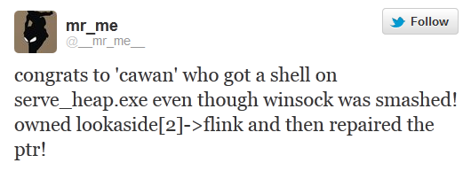
Heap Corruption Bugs
Heap fixing not really viable
Modules store ptrs to the heap base (msvcrt, etc)
Data stored on the heap is overwritten
Today Heap exploits more refined
Much more control
Subtle changes that can possibly be reversed
Modify freelists and other structures

Slide 40
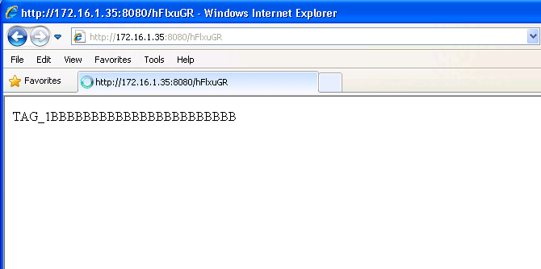
The State Of Browser Exploits

Slide 41
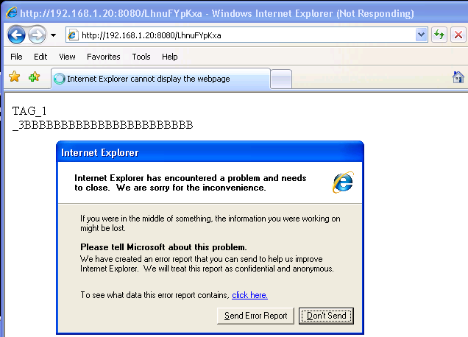

Slide 42
Bad Exploit, No Biscuit….

Slide 43
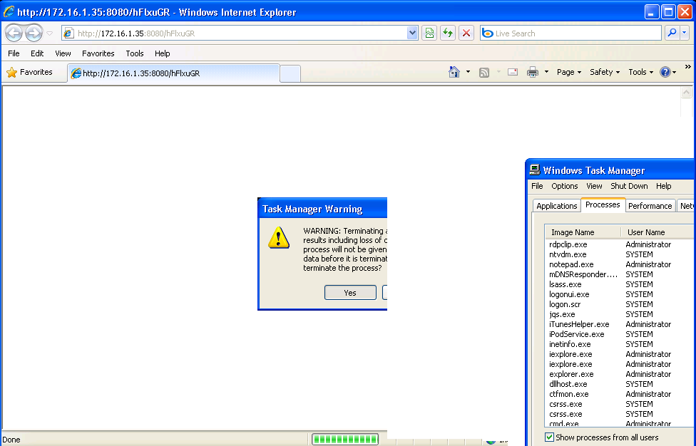
Bad Exploit, No Biscuit….

Slide 44
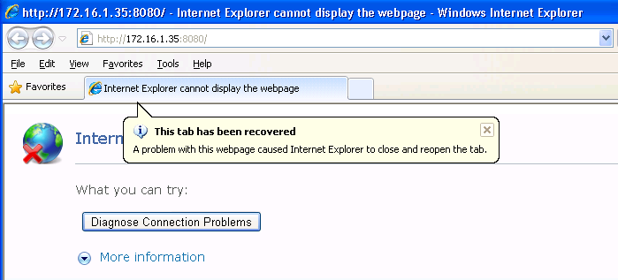
IE 8 Errors
IE 8 will reload a page that causes a crash
Exploit delivery must prevent this

Slide 45
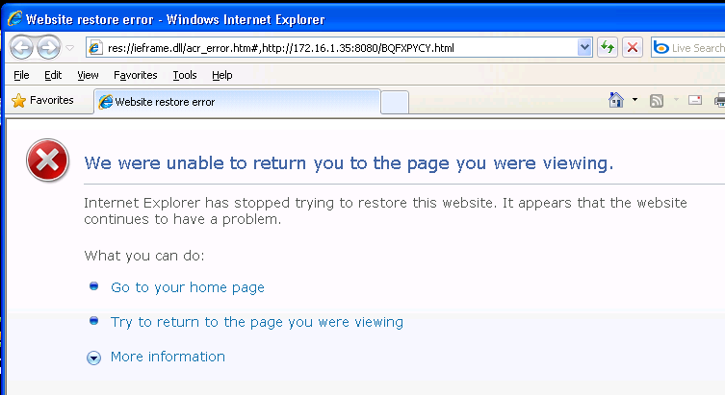
IE 8 Errors

Slide 46
Bye Bye Rootite
If that is the exit() part of the exploit
You just wasted your rootite
Obvious signs of exploitation
This is the current state of public exploits
Only seem to care about the connect back
No intention to hide a target crash

Slide 47
Use After Free
What is use after free?
Memory created
Memory reference stored
Memory freed
Memory space repopulated
Memory reference used
Reference ptr
Memory Chunk 1
Memory Chunk 2
Memory Chunk 3
New Memory Chunk 2

Slide 48
Browser Based Use After Free
OBJECT 1
Vtable Ptr1 0x00545460 OutputText()
Vtable Ptr2 0x00545560 RemoveText()
Vtable Ptr3 0x00545660 Destroy()
OBJECT 2
Vtable Ptr1 0x00545460 OutputText()
Vtable Ptr2 0x00545560 RemoveText()
Vtable Ptr3 0x00545660 Destroy()
OBJECT 2
Vtable Ptr1 0x0D0D0D0D OutputText()
Vtable Ptr2 0x41414141 RemoveText()
Vtable Ptr3 0x24242424 Destroy()
Valid function pointers
Overwritten function pointers

Slide 49
Browser Based Use After Free
Should be almost always recoverable
No real ‘memory corruption’
Fully controllable
This is not new
One of the only references I found
snf _at_ hdlsec.com
2010.11.15 http://hdlsec.com
http://hdlsec.com/exploiting/process-continuation-after-exploit-aka-internet-explorer-is-my-process-launcher/
The approach
Save registers, Push marker
Find mark, restore registers

Slide 50
Browser Based Use After Free
The code
;;; lets patch vtable address
and dword [edi], 0xFFFFFFFE
;;; save registers
pushad
;;; push a mark on the stack
push 0xdead1337
;; here starts the shellcode for launching the calculator
;; ============================================
[SHELLCODE GOES HERE]
;; ============================================
;;; then recover stack, search for our mark
l10:
pop eax
cmp eax, 0xdead1337
jne l10
;;; restore registers
popad
;;; return from the function with error
xor eax,eax
ret
No DEP bypass

Slide 51
MS10-018 - IEPEERS
Using Nicos exploit
Reliable, clean,… reliable
http://www.immunitysec.com/downloads/APT_kiwicon.pdf
Exploits use after free
Includes DEP bypass
Exits with TerminateProcess()
Next steps
Add process continuation

Slide 52
MS10-018 - IEPEERS
Find the vtable call
Find a suitable RET instruction

Slide 53
Save Registers
Dep bypass normally starts similar to this
Stack swap
pop 0x0D0D1024 to ESP
We need to save registers straight after this
Do care about ESP (Now in EAX)
Don’t care about EAX, ECX, ESI
Original values not used

Slide 54
Save Registers
PushAD
Pushes all registers to stack
Will return to EDI after
Don’t care about
original EDI
The Save Register Prefix
Pop new RET into EDI
Call PushAD
STACK
EDI
ESI
EBP
ESP
EBX
EDX
ECX
EAX

Slide 55
Save Register Prefix Code
Small and simple
Add ESP,2C
Needed to jump over the saved registers
ESP→
ROP CHAIN
0x77C23B47
0x77C4D7F6
0x77C12DF9
77C23B47 POP EDI
77C23B48 RETN
77C4D7F6 ADD ESP,2C
77C4D7F9 RETN
77C12DF9 PUSHAD
77C12DFA RETN

Slide 56
Restore Registers
After exploit completed
DEP bypass, migrate, connect back, etc
Restore registers and return

Slide 57
Post Return Fixup
Still more to be done
IE may reference the object again
Need to fix or remove other vtable calls
Fix any object data processing
Executing code now
Everything can be fixed
But does it work?

Slide 58
More Fixups
IE calls destructors
More vtable fixups required
Or we cheat and remove the call
Does it work now….

Slide 59
Summary
Process continuation is possible
And easy for IE use after free
Much more work to be done here
References
Nico Waisman - Aleatory Persistent Threat
http://www.immunitysec.com/downloads/APT_kiwicon.pdf
Skylar - Writing User-Friendly Exploits
http://www.immunitysec.com/downloads/skylar_cansecwest09.pdf
Ben Nagy - Industrial Bug Mining
http://www.coseinc.com/en/index.php?rt=download&act=publication&file=Industrial%20Bug%20M iningBHreal.pdf
snf at hdlsec.com
http://hdlsec.com/exploiting/process-continuation-after-exploit-aka-internet-explorer-is-my- process-launcher/

Slide 60
www.insomniasec.com

